Slide 1
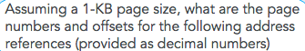
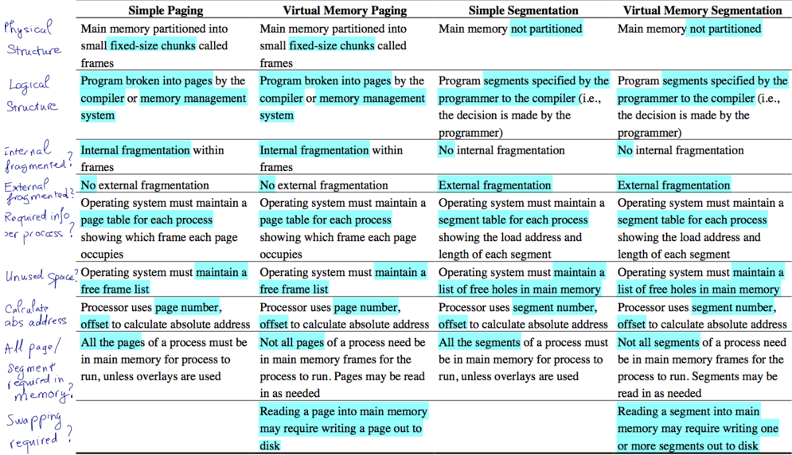
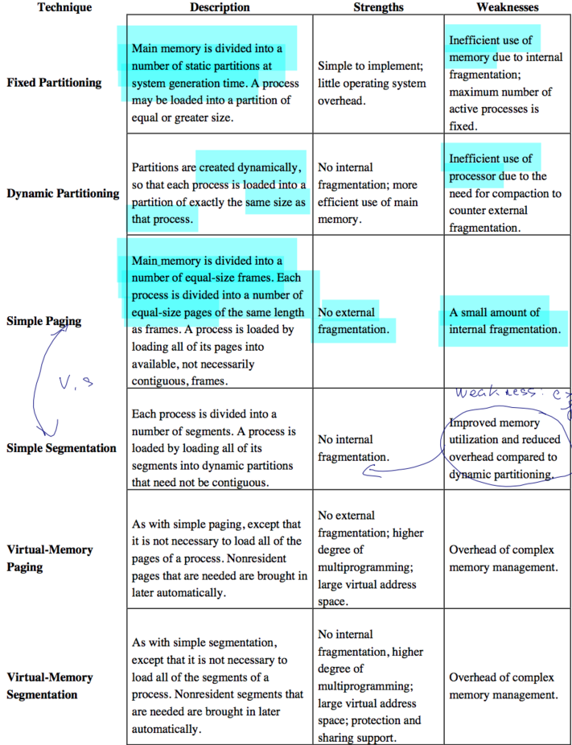
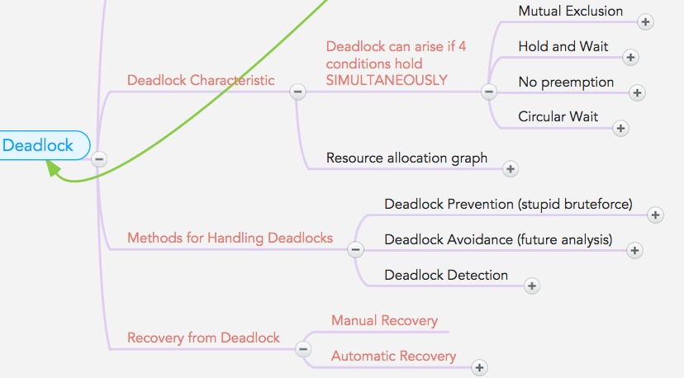
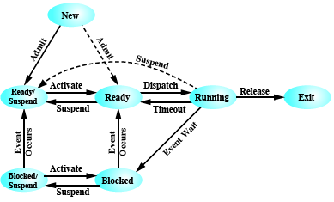
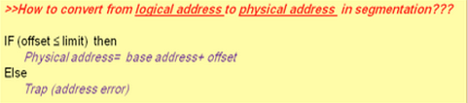
- Long term scheduler control the degree of programming
- Sync on OSes: - Solaris: Adaptive Mutex, Reader-Writer Locks, Turnstile (Q); XP:singleproc:disable interrupt,multi:spinlocks & DispatcherObject; Linux: same with no Dispatcher
- Effective Access Time = ∑ prob x accesstime of each case - On UMA systems, accessing RAM takes the same amount of time from any CPU. On NUMA systems, accessing some parts of memory may take longer than accessing other parts of memory, thus creating a performance penalty for certain memory accesses. - Paging arithmetic laws: Page size = frame size Logical address space (/size) = 2m | Page size= frame size= 2n Physical address space (/size) = 2x (x: bits in physical address Logical address space (/size) = # of pages × page size Physical address space (/size) = # of frames × frame size # of pages= 2m-n # of entries (records)in page table = # of pages - predict next CPU burst: Τn+1= α * tn + (1- α) * τn
- to ensure that Circular Wait condition never holds is to impose a total ordering of all resource types, and to require that each process requests resources in an increasing order of enumeration. - The benefits of multithreaded programming fall into the categories: responsiveness, resource sharing, economy, and utilization of multiprocessor architectures. - Blocking and Nonblocking I/O
ØBlocking ­ process suspended until I/O completed ØNonblocking ­ Returns quickly with count of bytes read or written ØAsynchronous ­ I/O subsystem signals process when I/O completed - System Call Parameter Passing: methods used to pass parameters to the OS
1. Simplest: pass the parameters in registers 2. Parameters stored in a block, or table, in memory, and address of block passed as a parameter in a register. This approach taken by Linux and Solaris 3. Parameters placed, or pushed, onto the stack by the program and popped off the stack by the operating system
Types of System Calls:
Process control - File management - Device management -Information maintenance- Communications - Protection CPU scheduling decisions may take place when a process:
o Switches from running to waiting state o Switches from running to ready state o Switches from waiting to ready o Terminates
Scheduling Criteria
· CPU utilization – keep the CPU as busy as possible
· Throughput – # of processes that complete their execution per time unit
· Turnaround time – amount of time to execute a particular process
· Waiting time – amount of time a process has been waiting in the ready queue
· Response time – amount of time from when a request was submitted until the first response is produced.
- fork retun 0 indicates the child process, >0 is parent.

Slide 2
